Slide 1
Baltimore, Maryland
Neighborhoods Explored by Number of Crimes and Vacant Buildings

Slide 2
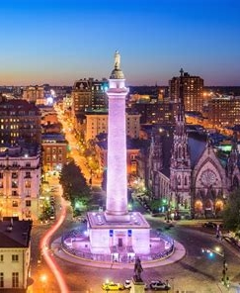
Baltimore in Trouble
“Charm City” has a shrinking population, high crime rate, and bleak outlook
To explore the problems of the city we are looking at the relationship between
Number of Crimes
Number of Vacant Buildings
Explore venues available in the top 5 neighborhoods by crime and vacant buildings

Slide 3
Data
Data comes from open city data for Baltimore City, Maryland
https://data.baltimorecity.gov/
Crime Data
https://data.baltimorecity.gov/Public-Safety/BPD-Part-1-Victim-Based-Crime-Data/wsfq-mvij/data
Vacant Building Data
https://data.baltimorecity.gov/Housing-Development/Vacant-Buildings/qqcv-ihn5/data
Neighborhood GIS information
https://data.baltimorecity.gov/Geographic/Neighborhoods/h8i5-gvdz
Foursquare
https://api.foursquare.com

Slide 4
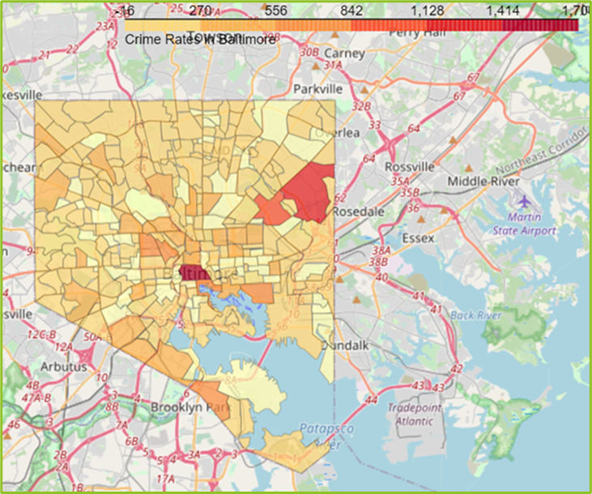
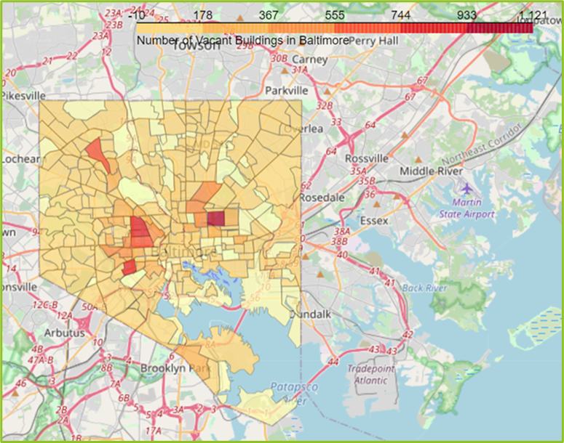
Crime vs Vacant Buildings
Number of Crimes by Neighborhood
Number of Vacant Builders by Neighborhood

Slide 5
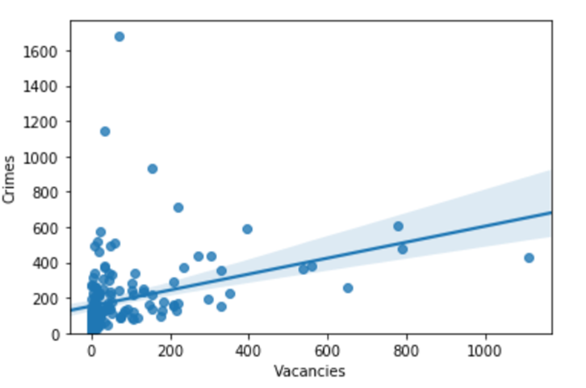
Correlation?
Maps show little overlap between high crime and high vacancies
Using a regression model to view relationship
Correlation coefficient of only 0.344
WEAK CORRELATION

Slide 6
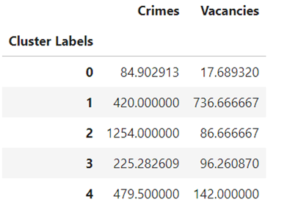
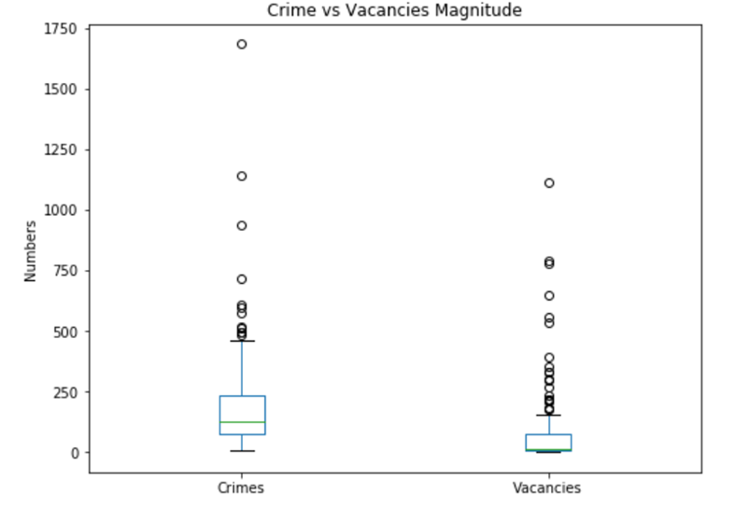
Clusters
K-cluster to group the neighborhoods
Get the mean values for the labels
Compare the numbers for crime and vacant buildings
Create labels for each category
Cluster | Label
0 | Low Crime, Low Vacancy
1 | High Crime, High Vacancy
2 | Highest Crime, Med Vacancy
3 | Med Crime, Med Vacancy
4 | High Crime, Med Vacancy

Slide 7
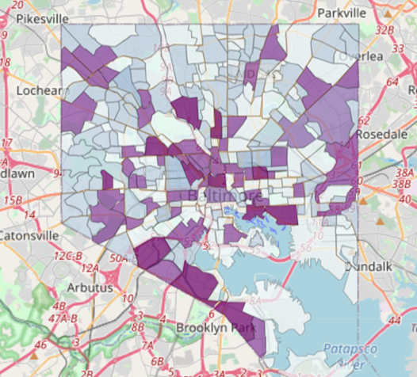
Clusters Mapped
Low Crime and Low Vacancy areas matched up which was expected
Unexpected is that the Highest Crime areas had a Medium Vacancy number
The Medium Vacancy number had crime Numbers in the Low, Medium, and High range
Due to the weak correlation, that is not unexpected

Slide 8
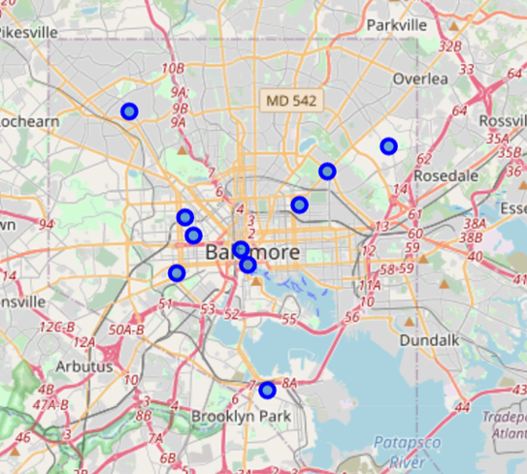
Exploring Neighborhoods
Taking the top five neighborhoods by number of vacant buildings and number of crimes respectively
Combine into one top ten neighborhoods of interest list

Slide 9
Venues
Neighborhoods of Interest have few venues with two exceptions
Neighborhood | Number of Venues
Belair-Edison | 12
Broadway East | 6
Brooklyn | 6
Carrollton Ridge | 15
Central Park Heights | 5
Downtown | 66
Frankford | 3
Harlem Park | 4
Inner Harbor | 72
Sandtown-Winchester | 5
Downtown and Inner Harbor were pulled as top five neighborhood in terms of crime
Crime may be a result of large number of people in neighborhood
Most neighborhoods with high vacancy or high crime have few amenities

Slide 10
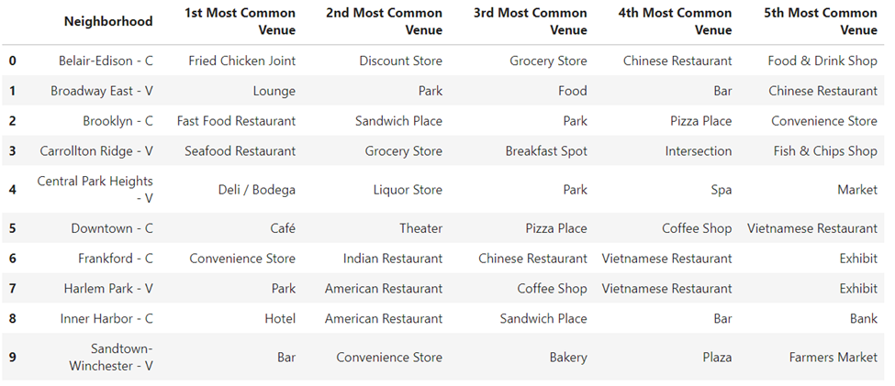
Top Venues in Neighborhoods

Slide 11
Conclusion
Weak correlation between crime number and number of vacant buildings
Unexpected result
Happens when modeling information
Areas with high vacancy or high crime have few amenities
Exception are two high tourist areas, Downtown and Inner Harbor
More exploration needed to determine if outliers
Possible high tourist areas attract crime
Further Study
Compare type of crimes across neighborhoods
Determine true percentage of vacant buildings vs pure numbers

